Slide 1

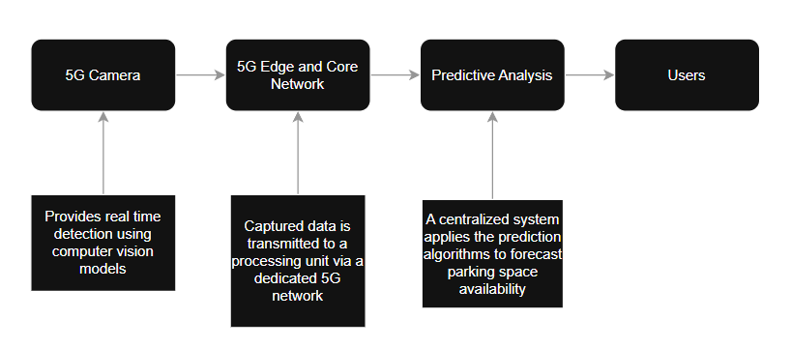
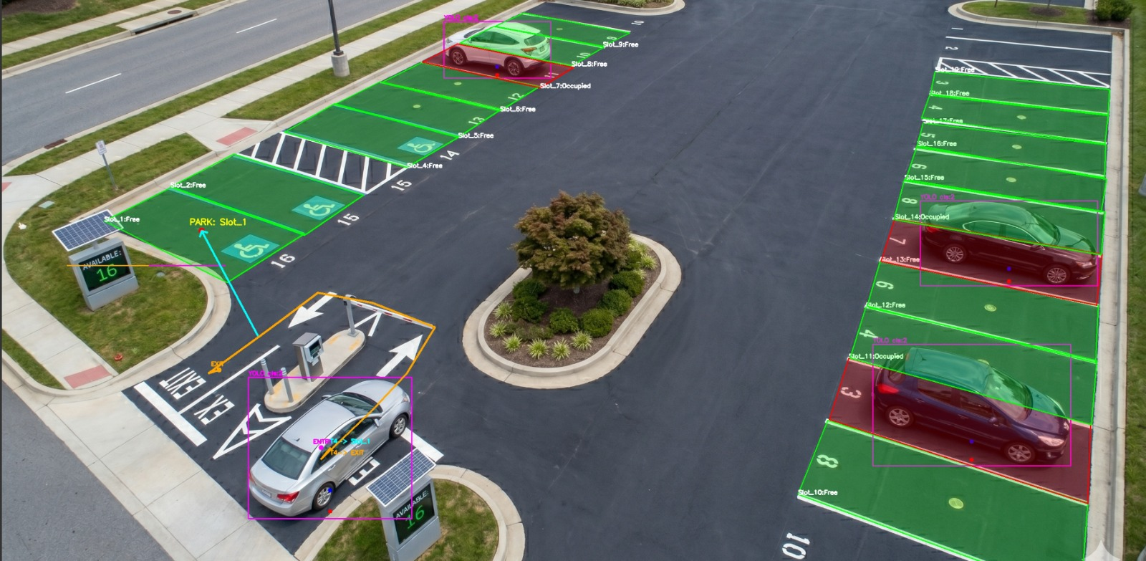
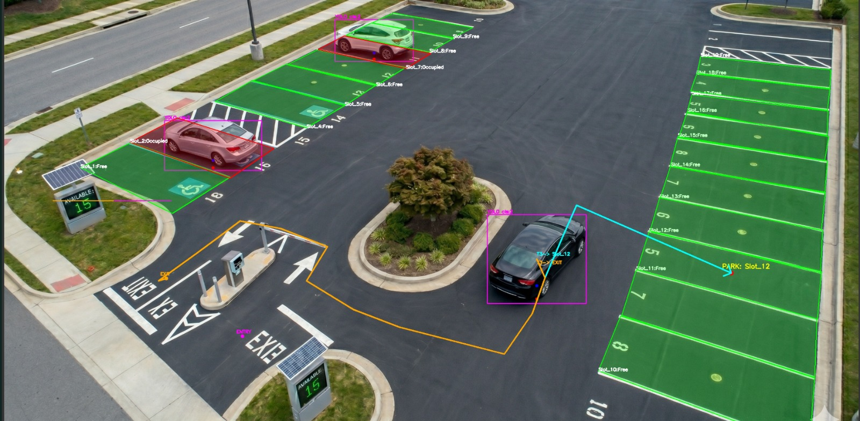
5G Smart Parking System
Shreyash Bharati, Aryan Patel, Yash Varshney
*Department of Electronics and Communication Engineering,
Indian Institute of Technology Guwahati
Abstract
We are designing a 5G enabled smart parking system that uses camera-based detection as well as lightweight ML prediction models.
Main Results
The parking system marks the occupied spots and incoming cars.
The pathway to the nearest parking spot and exit is also shown to the driver.
Block diagram of the model
Working of the proposed model
As we can observe in the first image, we can see the parking spots which have been occupied marked in red. We can also see that the entry and exit spots have been marked.
Here, we can observe that the path to the nearest parking spot is being shown to the driver in blue markers and the path to the exit is being shown in orange markers.

